Slide 1


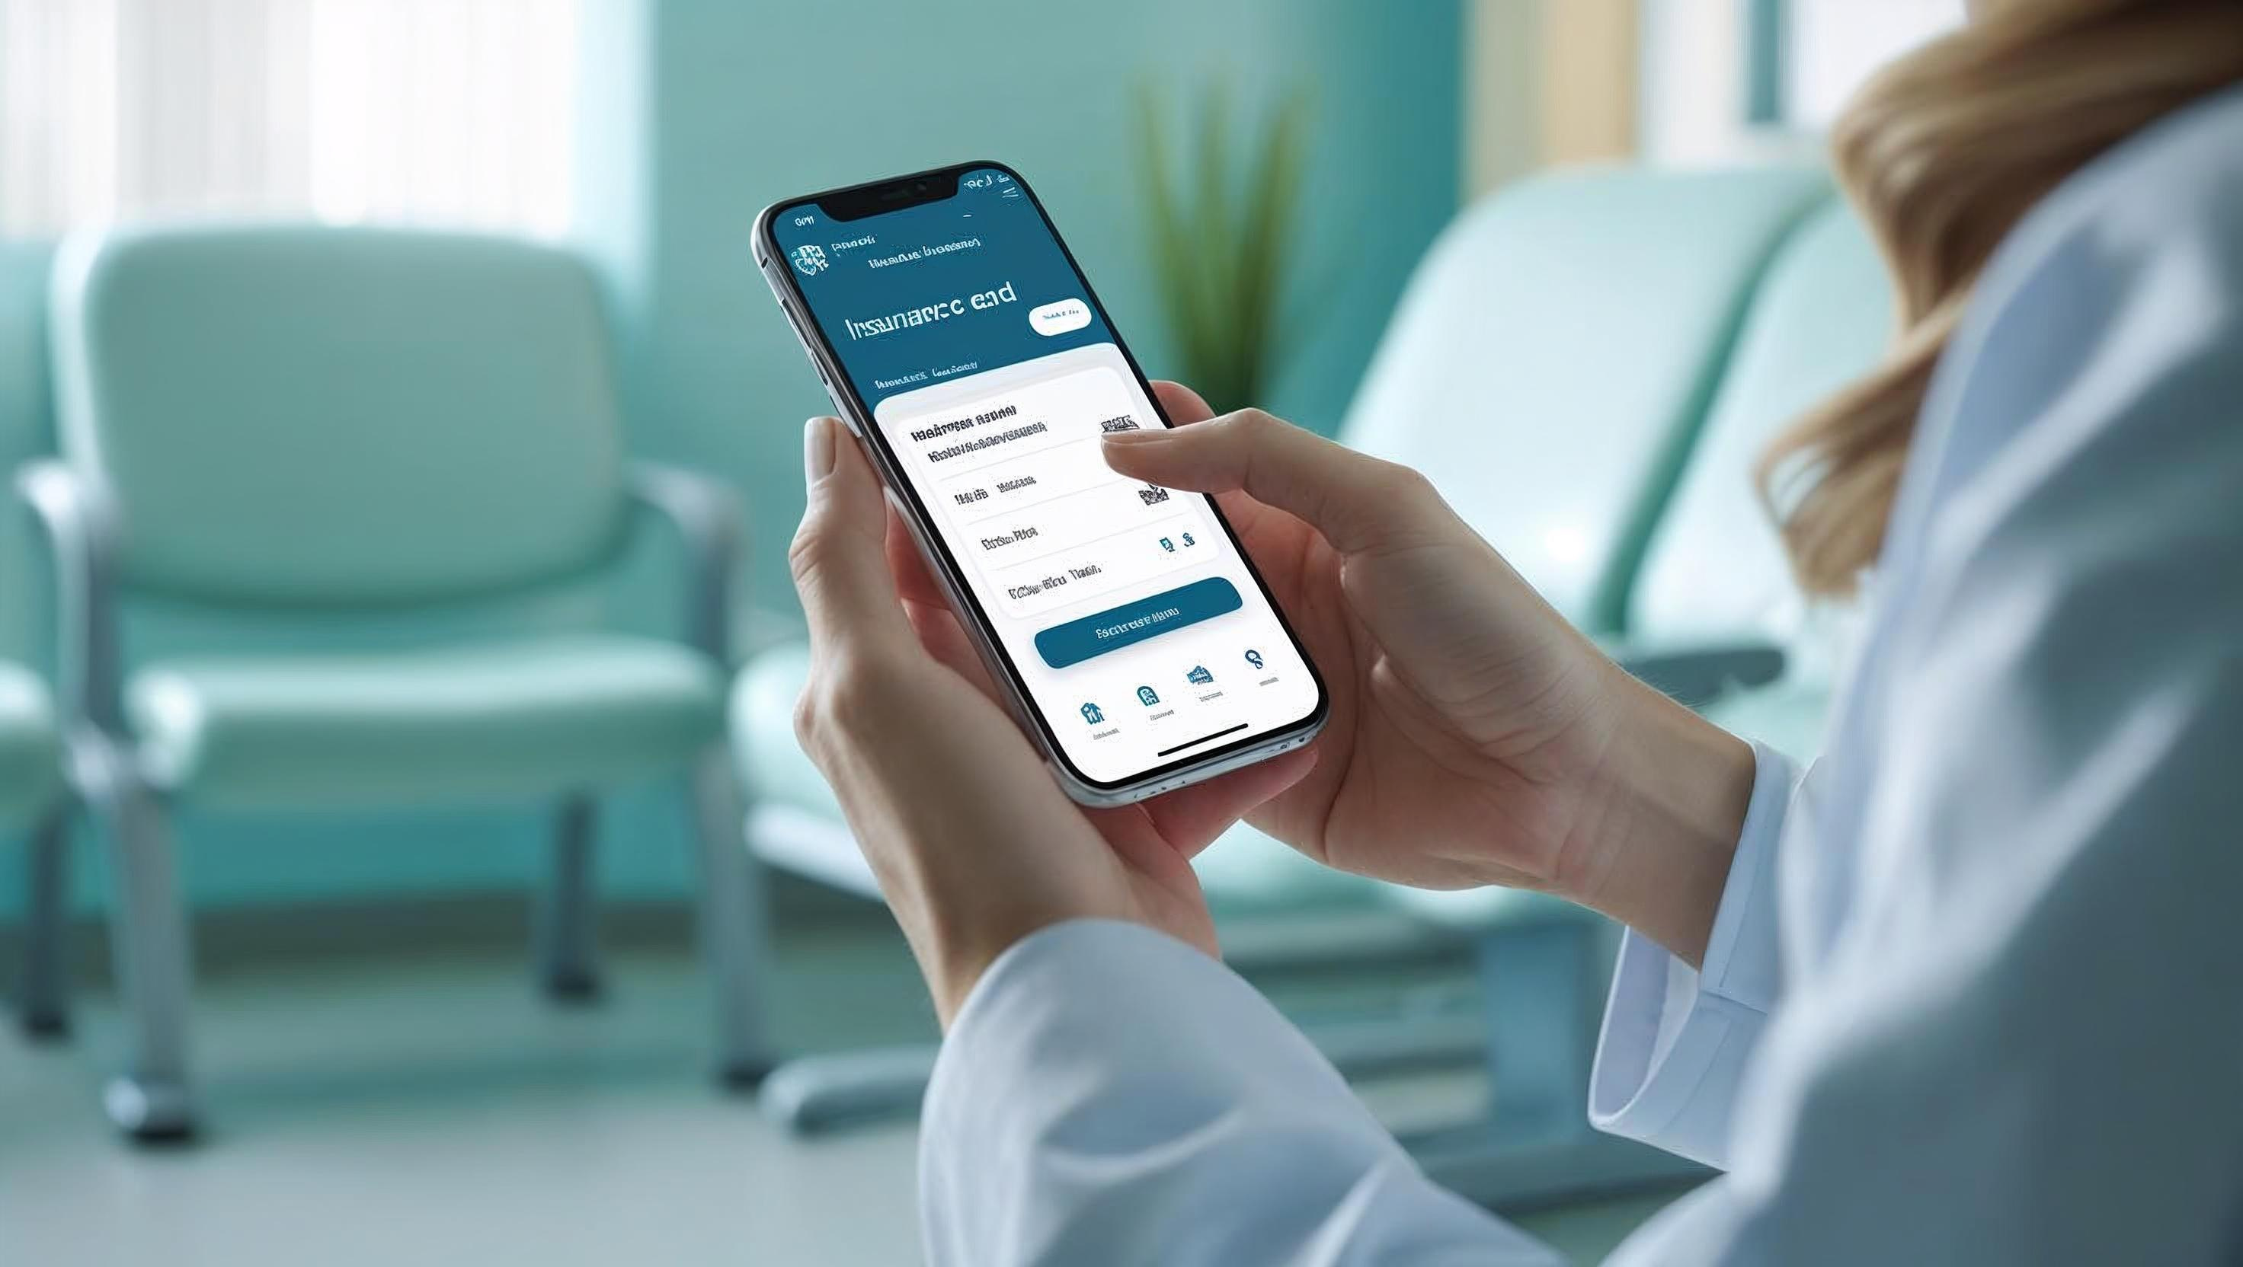
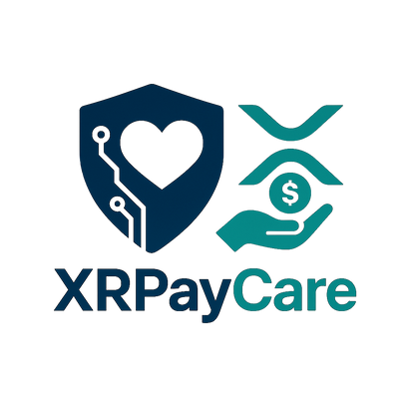
XRPL
Home
About
Product
Contact
XRPayCare

Slide 2
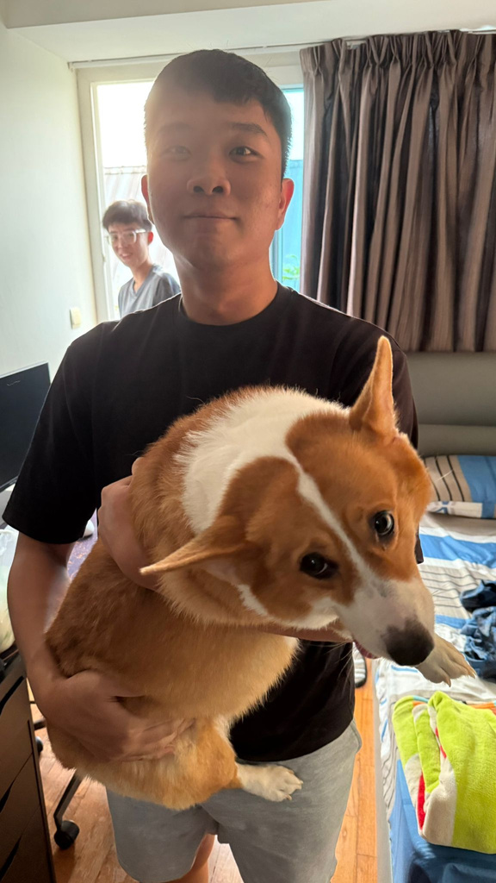
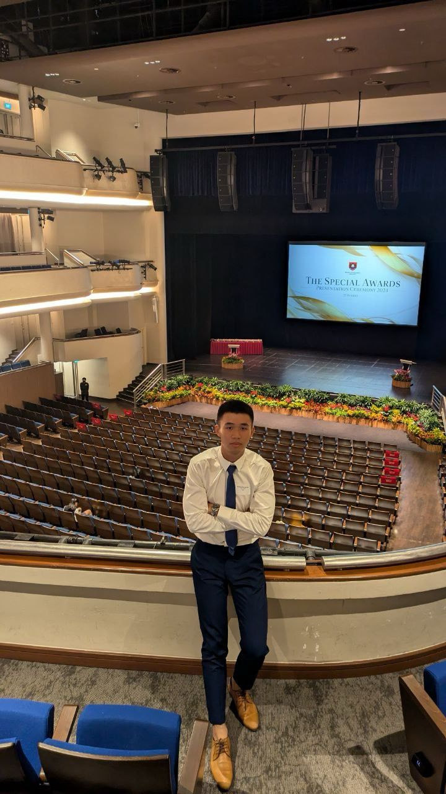
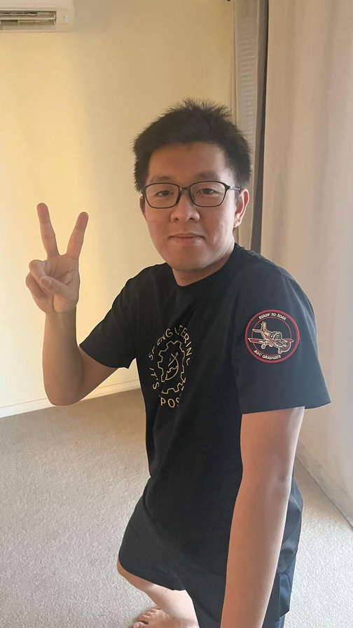
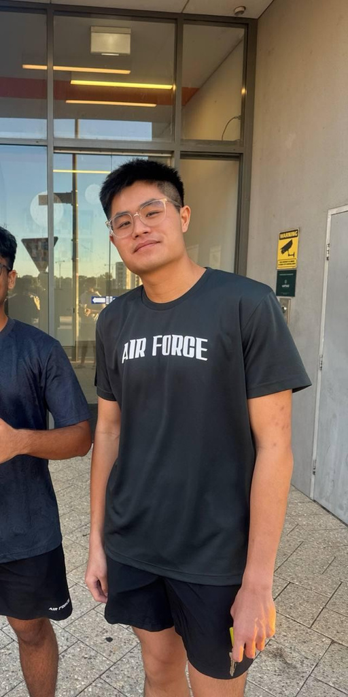
XRPL
Home
About
Product
Contact
MEET THE TEAM at XRPayCare
Gareth
Randall
Joshua
Zavier
Diploma in Aerospace Electronics
Diploma in Computer Engineering
Diploma in Aerospace Engineering
Diploma in Aviation Management

Slide 3
XRPL
Home
About
Product
Contact
PROBLEM
Significant amount of people struggle to afford medical expenses
~ 2 billion people face financial hardship due to out-of-pocket health spending
> 1 billion people (14% global population) experience large out-of-pocket payments
~ 1.3 billion individuals were pushed into poverty by healthcare payments
Source: WHO & World Bank, UHC Global Monitoring Report (2023)
Notes:
We’re tackling a global problem: the crushing cost of healthcare.
According to the Universal Health Coverage Report 2023:
Nearly 2 billion people face severe financial hardship due to out-of-pocket healthcare costs.
Over 1 billion see their household budgets heavily burdened.
And around 1.3 billion are pushed into poverty because of medical expenses.
These numbers highlight an urgent need for change.

Slide 4
XRPL
Home
About
Product
Contact
SOLUTION
Alleviate financial burden of medical expenses by creating a global funding platform
Leverages AI
Powered by RLUSD & XRP Ledger
Determine the required funding amount in real time
Verify legitimacy* & eligibility* of fundraising campaigns
Enables global, fast, secure, low-cost and transparent financial transfers
Provides price stability
*Part of Phase 1 plans
Notes:
Healthcare is a universal human right, as recognized by the WHO.
Our solution is a global funding platform that uses AI to verify medical campaigns and accurately calculate the amount needed in real time based on individual profiles.
Powered by RLUSD on the XRP Ledger, the platform ensures price stability and enables fast, secure, low-cost, and transparent global financial transfers.

Slide 5
XRPL
Home
About
Product
Contact
MVP DEMO
Notes:
We will now begin the demonstration of our MVP.

Slide 6

XRPL
Home
About
Product
Contact
HOW IS XRPL USED?
Transparent and Immutable Records
Fast, Secure & Cost Efficient Payments
Stable Transfers using RLUSD
Automated Escrow Functions
Real-time Auditability
Notes:
The XRP Ledger powers our platform’s fundraising system with speed, transparency, and trust.
Every transaction is recorded on-chain for full transparency and fraud prevention.
XRPL enables near-instant, low-cost global payments, and we use RLUSD, a stable asset, to protect users from crypto volatility.
Funds are held in automated escrow, released only when goals are met — giving donors real-time visibility and confidence.

Slide 7
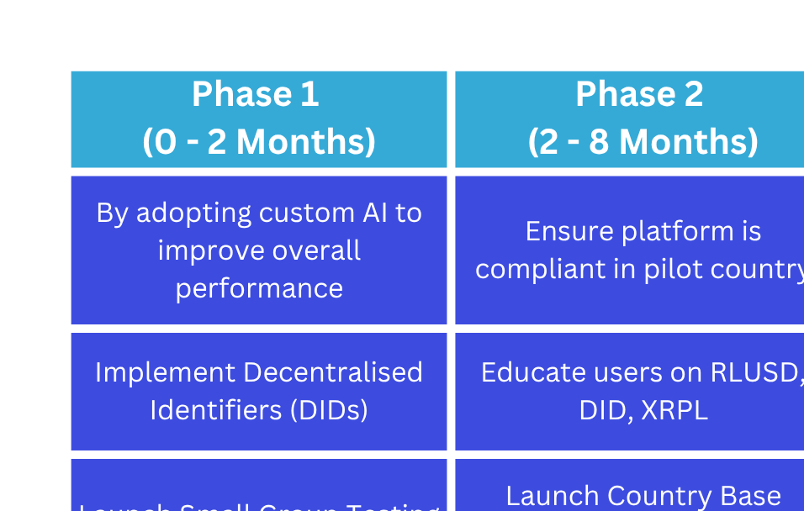
XRPL
Home
About
Product
Contact
FUTURE ROADMAP
Notes:
The future roadmap of our platform follows a progressive improvement model, with clearly defined goals for each phase.
Our approach ensures that each milestone is met before moving forward, leading up to a global launch.
The full development journey is expected to span approximately 34 months of continuous refinement and innovation.
P1:
Custom AI: Eligibility and Legitimacy
DIDs: Solves challenges around trust, verification, privacy and compliance
P3:
More seamless integration between various providers (Insurance, Government Subsidy, Employer Health Benefits)
P4:
Integrate other stablecoins helps increase flexibility, adoption, and cross-border efficiency

Slide 8

XRPL
Home
About
Product
Contact
Thank You
Notes:
Thank you!

